Slide 1
CASE STUDY 1

Slide 2
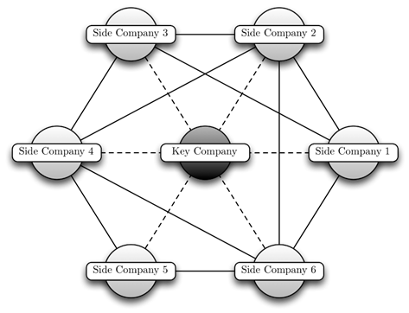
Notes:
A spider construction is a fraudulent setup with an active exchange of resources between the companies, i.e., fraudulent companies do not transfer all of their resources to only one other company as this might attract too much attention (see Figure 1a). They rather distribute their resources among many companies.
The side companies are the perpetrators of the fraud and have an observable link to each other through shared resources. The core of a spider construction is the key company, which is responsible for organizing the fraud, setting up many side companies and pruning away their proﬁts, so that they go bankrupt. However, the key company has unobservable links, and therefore we can only detect the side companies.
A shell corporation is a company or corporation that exists only on paper and has no office and no employees, but may have a bank account or may hold passive investments or be the registered owner of assets, such as intellectual property, or ships. The company may serve as a vehicle for business transactions without itself having any significant assets or operations. Sometimes, shell companies are used for tax evasion, tax avoidance, and money laundering, or to achieve a specific goal such as anonymity.

Slide 3
Technologies used
Small networks or Initial/Partial analysis: –
Python / NetworkX
NodeXL, SVAT
Huge networks –
Graph databases, such as Neo4j – Distributed systems like Spark/Hadoop
Gephi
Notes:
Why technology is required?
It is requisite to summarise all the information and make an interpretation – a task which is traditionally completed by investigators. With the development of computer technology, some programmes, such as Qlik or Tableau, could be applied to comprehensively display trends and variables, so that the whole story can be seen.

Slide 4
SOME EXAMPLES

Slide 5


Slide 6
Century Communication Group
It used to run Mahua Channel [A Bhojpuri TV channel]
Committed fraud to the tune of Rs 3,000 crore
It used over 98 shell companies to allegedly divert bank loans for setting up digital studios in Noida, Mumbai, Kolkata and other locations.
Divert funds by showing fake equity infusion of about Rs 802 crore

Slide 7
How CBI and we can detect fraud?
Focus on significant transactions  Trend Analysis
Unusual debits/credits in accounts
False credits, with corresponding debits, from/to dummy accounts, etc.
Ratio Analysis
Abnormal numbers / data
Historical Comparisons
Investigator’s Intuition & Common Sense
Notes:
Only when preventive measures and post-response actions complement each other can fraud risks be effectively deterred and controlled.

